Slide 1
Multiple Intelligences
School Counseling by Heart
The question is not
"How smart are you?"
it's "How are you smart?"
SchoolCounselingByHeart.wordpress.com

Slide 2
Multiple Intelligences = "Smarts"
There are lots of different kinds of smart - word smart, logic smart, picture smart, nature smart, people smart, self smart, music smart, and body smart.
We each have ALL of these kinds of "smarts" but in our own individual combination, with some stronger than others.
T
SchoolCounselingByHeart.wordpress.com

Slide 3
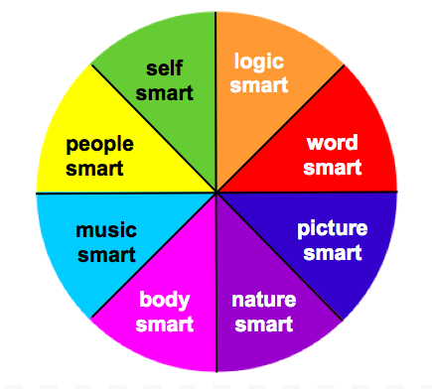
Multiple Intelligences
SchoolCounselingByHeart.wordpress.com

Slide 4
Word Smart
"Verbal-Linguistic Intelligence"
Good at and enjoy:
reading writing creating talking listening
explaining telling stories
playing word games and puzzles
SchoolCounselingByHeart.wordpress.com

Slide 5
Logic Smart
"Logical-Mathematical Intelligence"
Good at and enjoy:
calculating solving problems
organizing hypothesizing
categorizing analyzing
making patterns researching
using logical arguments
SchoolCounselingByHeart.wordpress.com

Slide 6
Picture Smart
"Visual-Spatial Intelligence"
Good at and enjoy:
art photography
designing graphing
working with maps mazes
making diagrams drawing plans
creating mental pictures
SchoolCounselingByHeart.wordpress.com

Slide 7
Music Smart
"Musical-Rhythmic Intelligence"
Good at and enjoy:
singing remembering songs rhyming
dancing keeping the beat rapping
playing instruments creating sound effects
remembering things by: making them into a rhyme, song, or rap
SchoolCounselingByHeart.wordpress.com

Slide 8
People Smart
"Interpersonal Intelligence"
Good at and enjoy:
understanding people working with others
cooperating caring
communicating leadership
managing and organizing people
SchoolCounselingByHeart.wordpress.com

Slide 9
Self Smart
"Intrapersonal Intelligence"
Good at and enjoy:
setting goals self-control
being responsible
thinking about and understanding their: learning, feelings, behavior, strengths and weaknesses
using their experiences to understand and explain things
SchoolCounselingByHeart.wordpress.com

Slide 10
Nature Smart
"Naturalist Intelligence"
Good at and enjoy:
taking care of animals being outdoors caring about the environment
learning about, exploring, observing, and investigating nature, animals, and the environment
SchoolCounselingByHeart.wordpress.com

Slide 11
Body Smart
"Bodily-Kinesthetic Intelligence"
Good at and enjoy:
movement acting
building fixing things
manipulating making things
learning actively
SchoolCounselingByHeart.wordpress.com

